Slide 1

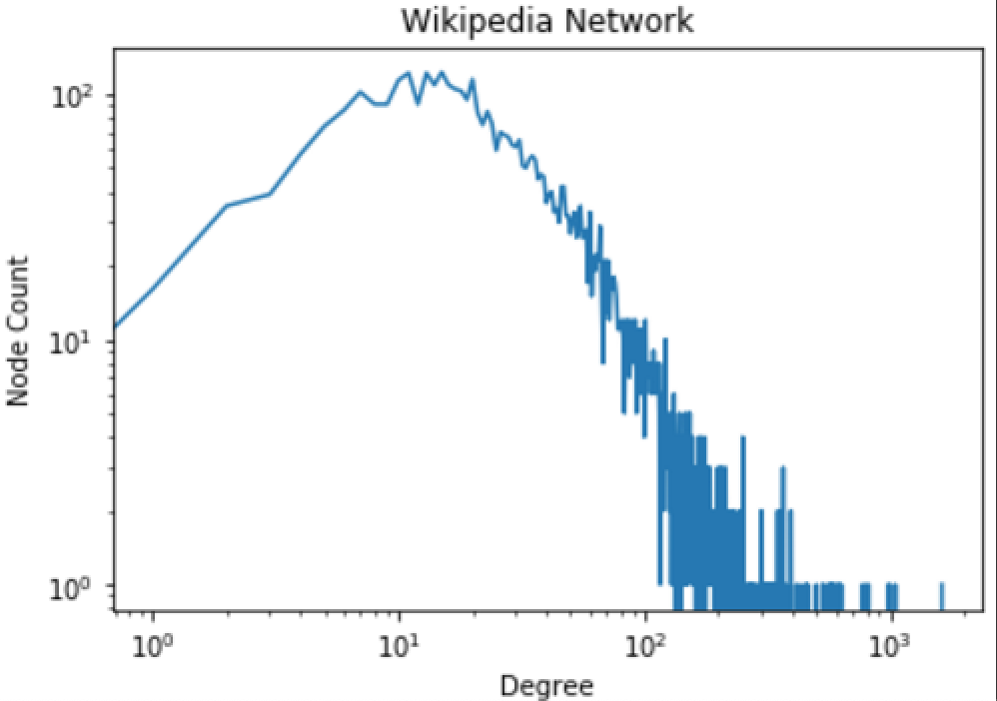
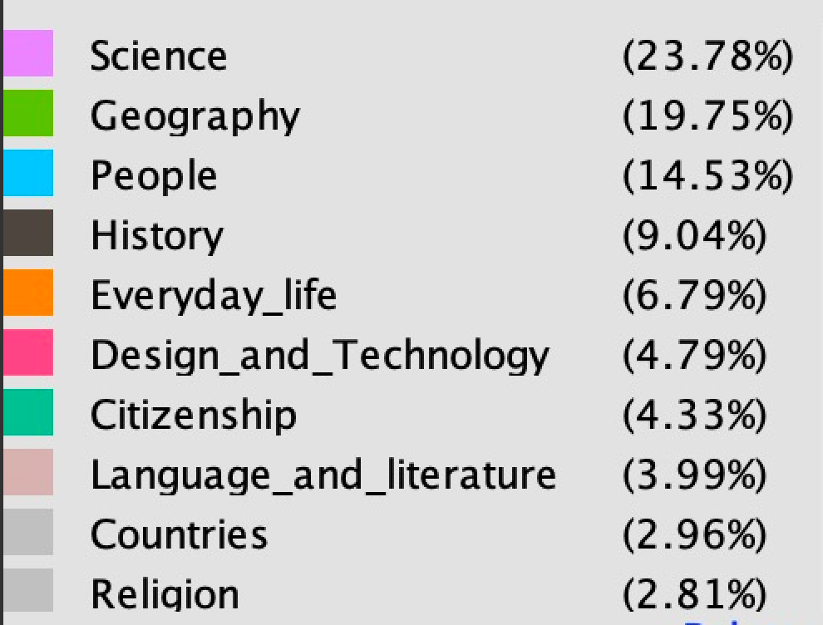
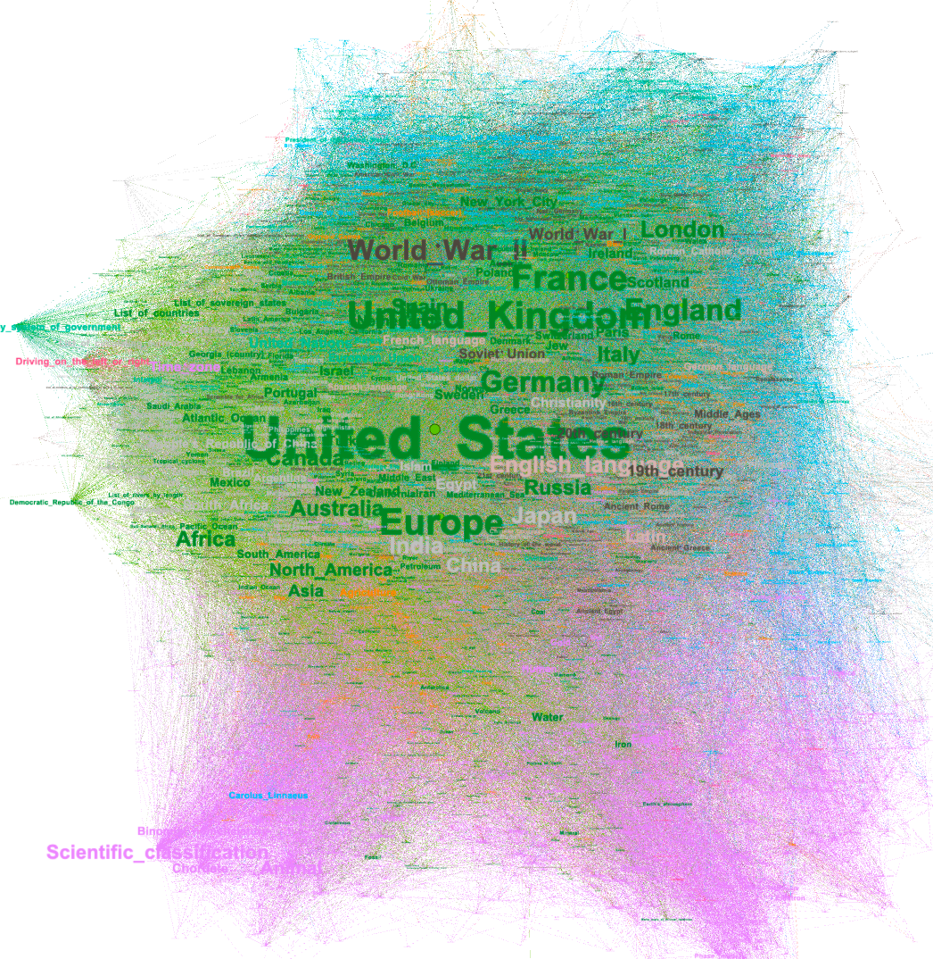
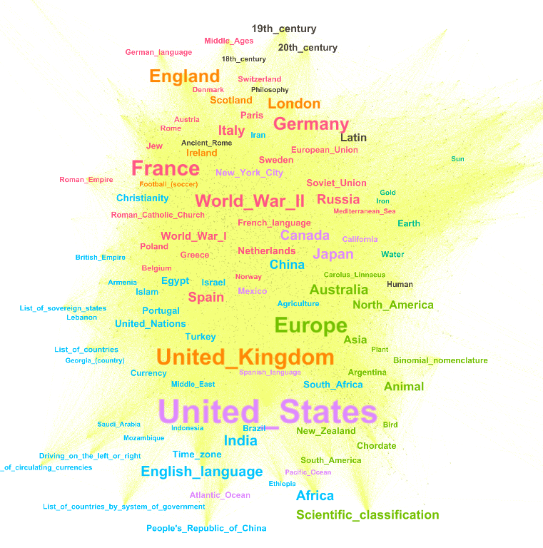
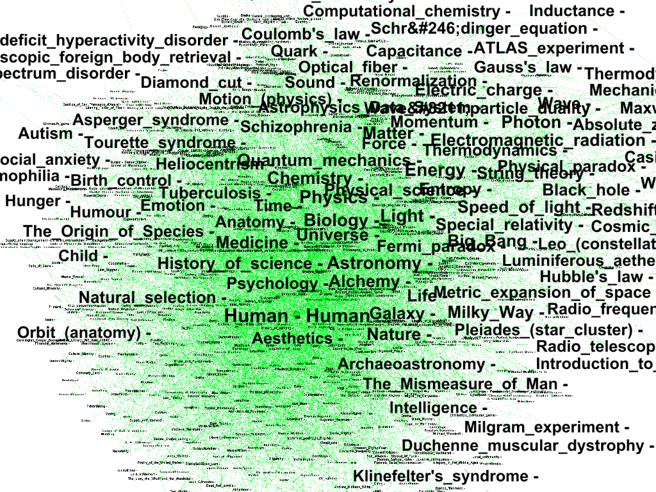
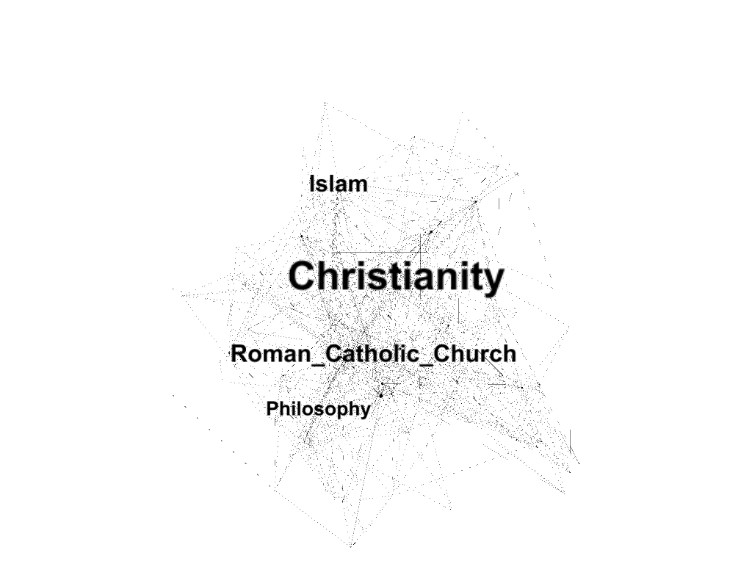
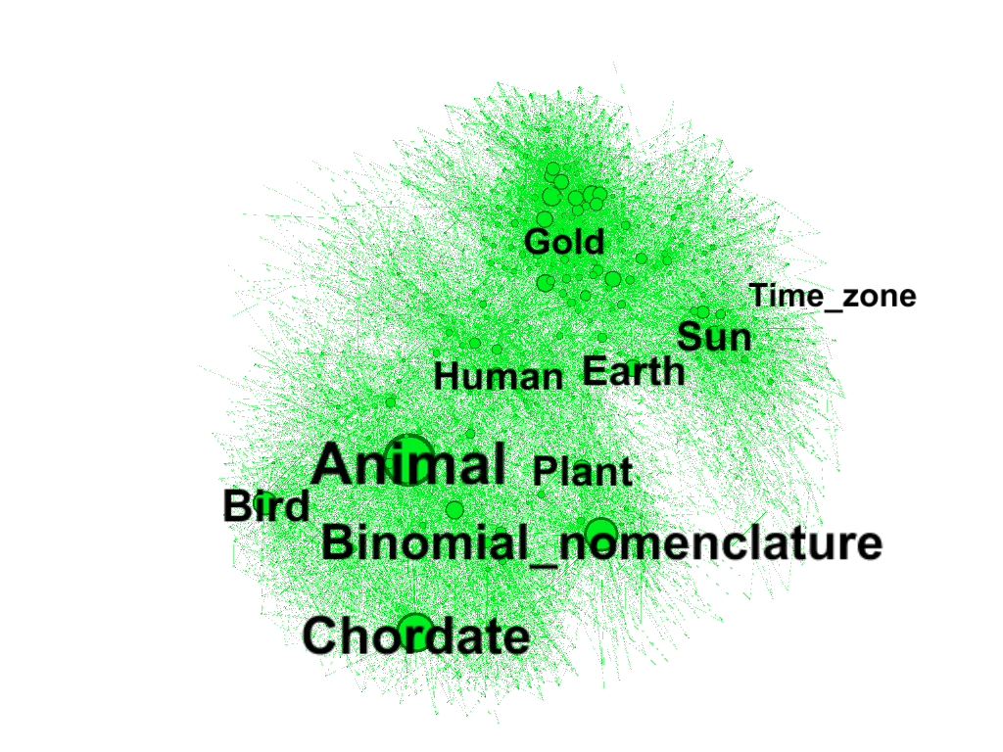
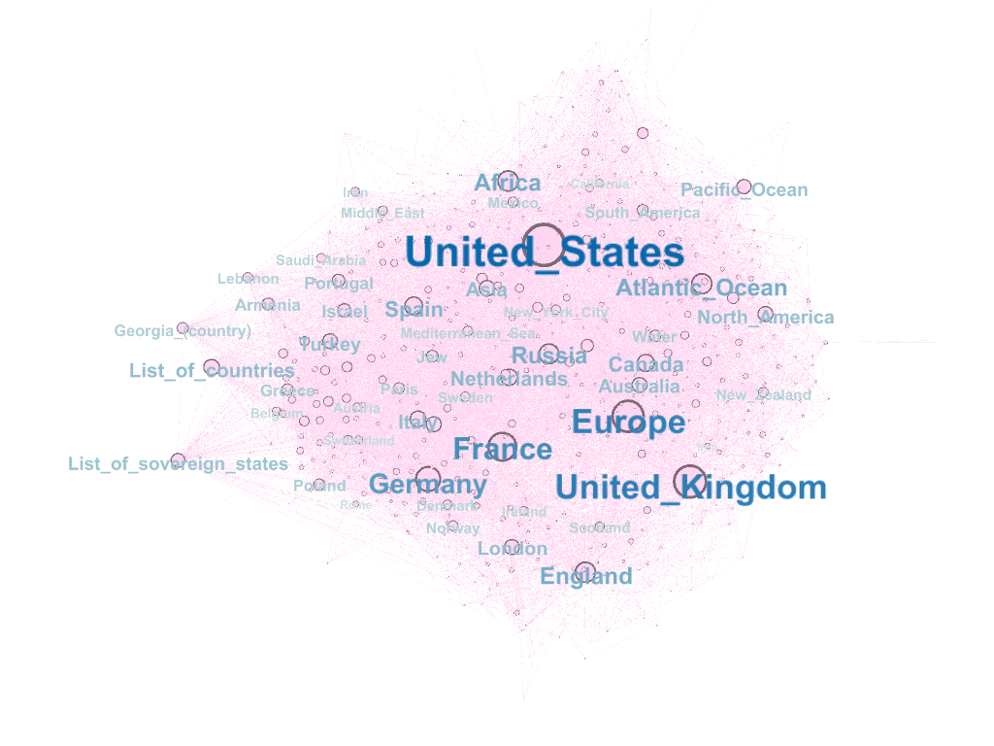
Wikipedia Links Network Analysis
Haoyuan Cao, Kalvin Goode, Hongquan Zhang, Jialu Zhao
ECE 227 Big Network Data
Objective
Results
Discussion
Wikipedia is one of the largest online encyclopedia and there are more than 5,000,000 articles in English. In each Wikipedia’s article, it provides links referencing other articles to offer additional information for users. In result, articles generate a big cross-referencing network. In this project, we are interested in investigating the most important articles from common knowledge using multiple methods in this Wikipedia network. The network has 4582 articles and 106647 links between them. Lastly, we interpret the results to understand essential concept in human society.
Degree distribution
From Figure 1. and Figure 2., the followings are the properties in this degree distribution:
Most nodes(links) have degree 10.
The largest degree is about 1000.
Country-related articles tends to have high degrees.
Articles are likely to mention United States, European countries, and World War II.
Links with physical presence, some of them also have large degrees like water, earth, gold, currency, sun, human and plant. There are some common features for all of them:
Refer to a large class
Has meaningful concept to cultures through the history (Four elements for ancient Greeks, Five elements in traditional Chinese philosophy)
About the fundamental and vital objects to survival (sun and water produce plant, plant produces animals, human eat plant, animals and water)
B. Category
Every article has a category, we calculated the amount of articles in different categories and showed it in Figure 5. and Figure 6.
(1) Science has the most amount of articles in Wiki.
(2) Art has the least amount in Wiki articles.
A. Degree distribution
Political topics or political problems have a dominant position than others that have topics in natural resources and animals. For example, World War II is ranked as seventh place in degree. It has large influence on modern world. It directly accelerating global agriculture and productivity, which is critical to economy.
The distribution is peaked in degrees between 10 and 20 and has long tail reaching 500 degree or more. This indicates that nodes with degree within 20 follow Poisson distribution while other nodes follows power law distribution.
One reason that most articles have at most 20 degree is that they are not related to critical or popular topics like politics and nature. In addition, some concepts were developed during contemporary period and thus have short history to make connection with others. For example, articles related to computers are presented in this network because all of us know the importance to the world. However, when compared with topics in politics after after world war II, computer is still in its infant age resulted in less degree in the network.
Another explanation is that most articles tend to be in stagnation if they are related to physical object, creations or compositions. For instance, Abacus is a calculating tool that was mainly use before the invention of computer. Obviously, Abacus has long history, so it is possible to have a great number of connections with others. However, article ‘Abacus’ only has 17 connections. Articles on physical object has small degree due to its narrow fields. It is rare to include other articles in the future since its definition won’t change.
Articles with higher degree tend to have higher visitors in any given period it (figure X). Not only it confirms the importance to human society, but also shows visitors are likely to visit the articles using existing connects from other similar articles.
B. Category
From previous analysis, we know that the United States is the most important article among Wiki network. By category, we found that most articles are related to science and geography. We believe it is because society has spent much of the resource on science, and there are opportunities related to science. On the other hand, compared to science, art has the least amount of articles. Possible reasons are that many artworks are less known to people, and concepts in art do not expand rapidly compare to science.
Figure X, Y, Z shows articles with large degree in religion, science and geography, respectively. In religion, unsurprisingly, we see that Christianity has the largest degree, while Roman Catholic Church is next. These two concepts has great influence in many cultures and history. Thus, other articles forms connection with these when it has history related to them. In science, Animal has highest degree. Its sub-category ‘Bird’ and ‘Chordate’ are also in the rank. In geography, the graph shows much more articles with high degree than other two categories. US, UK and Europe have largest degree indicate the term has been mentioned by thousands of articles. Even though the history of them is not long, most of the knowledge is related to them still shows their contribution to human society.
C. Community
Using greedy approach, the network is divided into seven subgraphs. In Figure X, it shows different communities with distinct color of article. With careful observation, article is assigned one of the communities if it has closer relationship with England, east culture, Europe, Human, Animal, Natural Resource and America.
Theory
There are 2 important network analysis methods that we learned in class that can be used in this wiki network analysis:
(1) Degree centrality
Degree centrality is defined as the number of links incident upon a node.
A node is more important if it’s more connected.
(2) Greedy Algorithm
Greedy algorithms build up a solution part by part and they always choose the next part that provide the most obvious and immediate benefit. So problems with greedy algorithm where choosing locally optimal also leads to global solution are best fit for greedy.
Figure . Wiki Network Degree Plot
Figure 6. Wiki Network Category Distribution
Conclusions
Wikipedia, the largest encyclopedia in the world, contains records of almost all subjects exits in this human society. Our work is trying to systematically analyze this network by modeling it as a cross-referencing network and gain insight using knowledge learned in graph theory.
Countries show top centralities in the graph. United States, especially, is the most important article measured by either degree centrality or betweenness centrality. This indicates that country is one of the most important, if it is not the top one, attribute of all subjects in human society. The concept of country plays an extremely important rule in the human history. Among all these countries, United States shows the largest impact.
Subjects categorized in science occupies more than one fifth of all subjects. Arts, however, accounts for about less than 4 percent.
Figure 4. Wiki Network Visualization by Degree
Figure 8. Wiki Network Visualization by Degree
Figure 1. Wiki Network Visualization by Degree and Category
References
1. Wikispeedia navigation paths. (n.d.). Retrieved from https://snap.stanford.edu/data/wikispeedia.html.
2. Robert West and Jure Leskovec: Human Wayfinding in Information Networks. 21st International World Wide Web Conference (WWW), 2012.
3. Robert West, Joelle Pineau, and Doina Precup: Wikispeedia: An Online Game for Inferring Semantic Distances between Concepts. 21st International Joint Conference on Artificial Intelligence (IJCAI), 2009.
4. Centrality. (2019, September 15). Retrieved from https://en.wikipedia.org/wiki/Centrality.
5. International Monetary Fund. (2019, November 26). Retrieved from https://en.wikipedia.org/wiki/International_Monetary_Fun
6. Greedy Algorithms. (n.d.). Retrieved from https://www.geeksforgeeks.org/greedy-algorithms/.
Figure 3. Wiki Network Visualization
Figure 5. Wiki Network Visualization by Degree
Figure 7. Wiki Network Visualization by Degree
Figure 9. Wiki Network Visualization by Degree

